Slide 1
UI/UX Worksheet
Project Title
PetMatch
Team members
6530262 Min Myint Moh Soe
6530289 Sai Oum Maing
6622085 Min Htet
6520102 Aung Bhone Naing
6530198 Heang Mengtry

Slide 2
Day 8

Slide 3
Assignment: Draw your wireflow
45 mins
Objective
To understand and be able to draw the wireflow of your project from the beginning until the end.
Instructions
Refer to your project, draw the wireflow of all steps from the beginning until the end.
Insert pictures and short descriptions of each step in your worksheet.

Slide 4

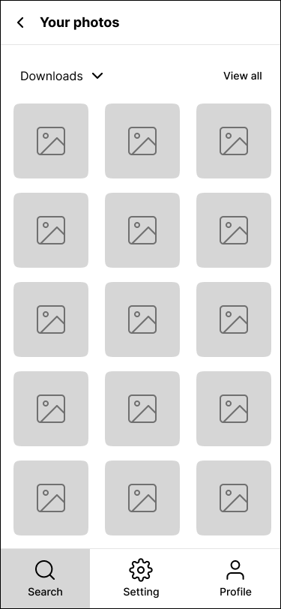
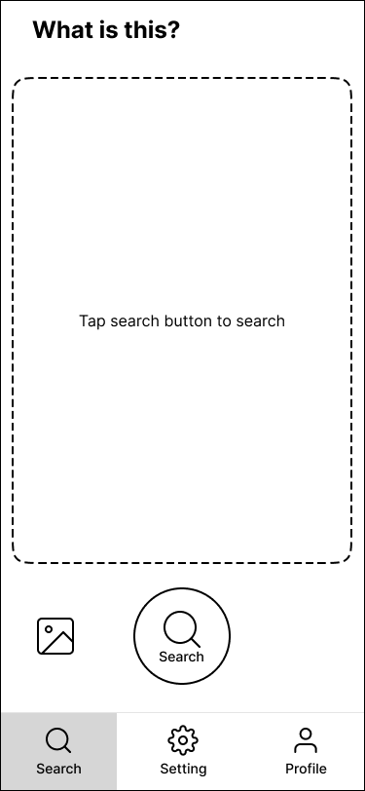
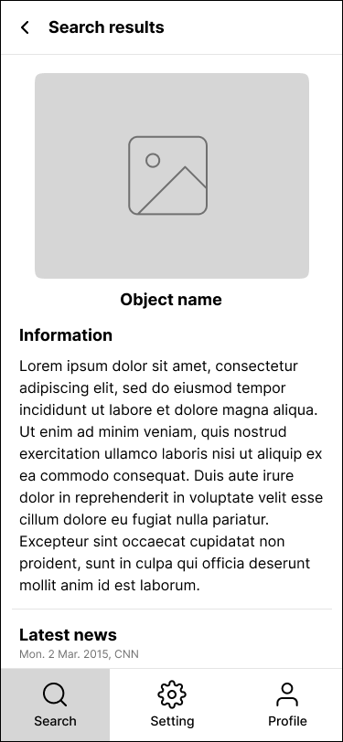
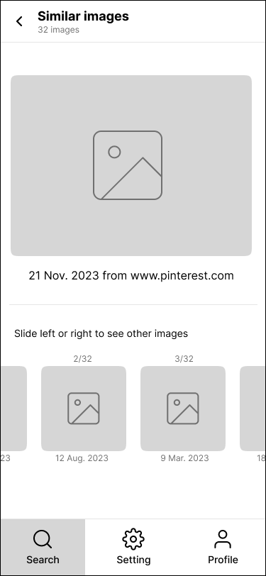
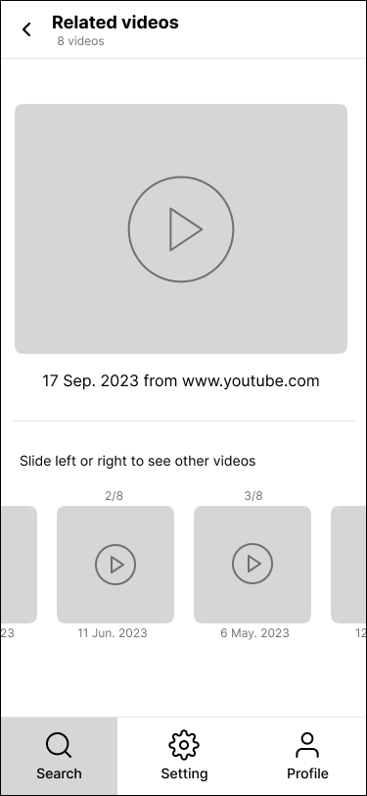
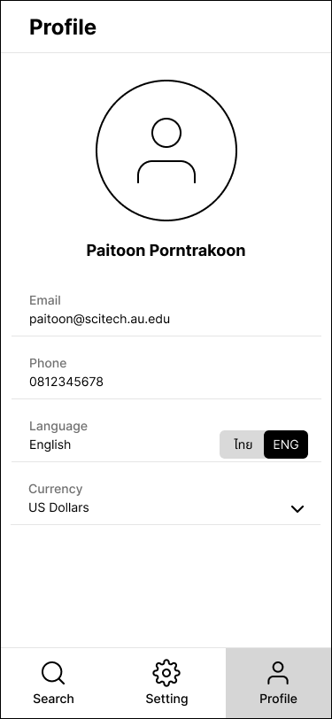
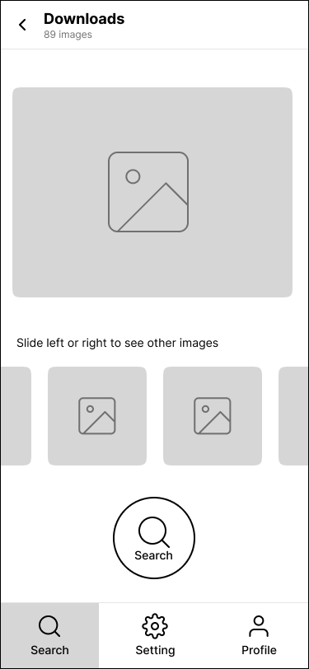
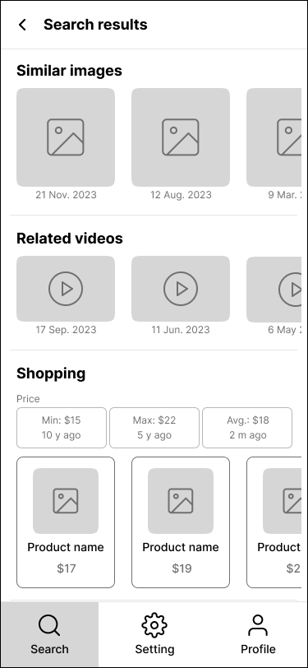
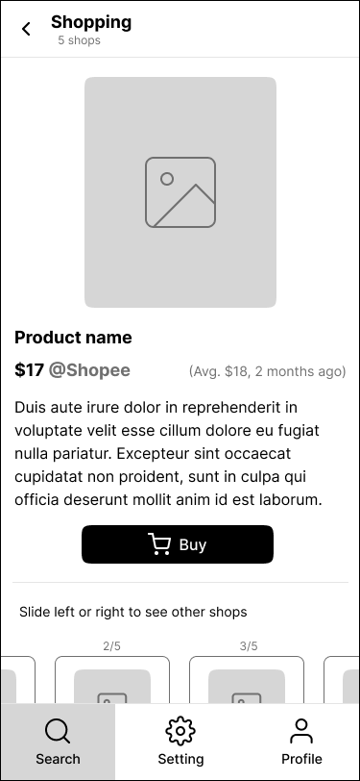
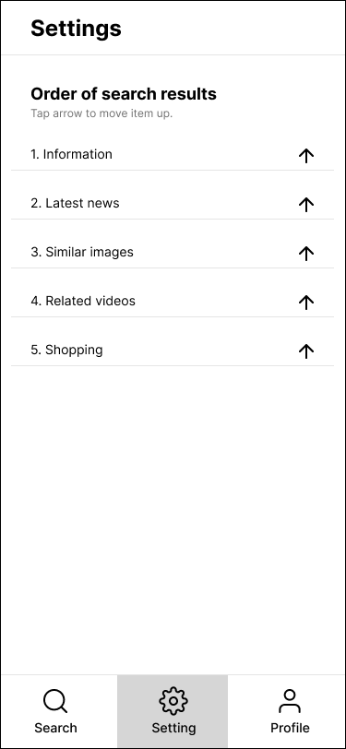
Wireflow (example)
Search by image 1
Search by camera
Search result 1
Profile
Open another app
Search by image 2
Search result 2
Shopping result
Settings

Slide 5
Assignment: Draw your wireflow
Grading Criteria
0 = Blank
1 = Incomplete steps from the beginning to the end.
2 = Complete steps are drawn although the flow is not clearly described.
3 = Complete steps are drawn, and the flow is clearly described.

Slide 6
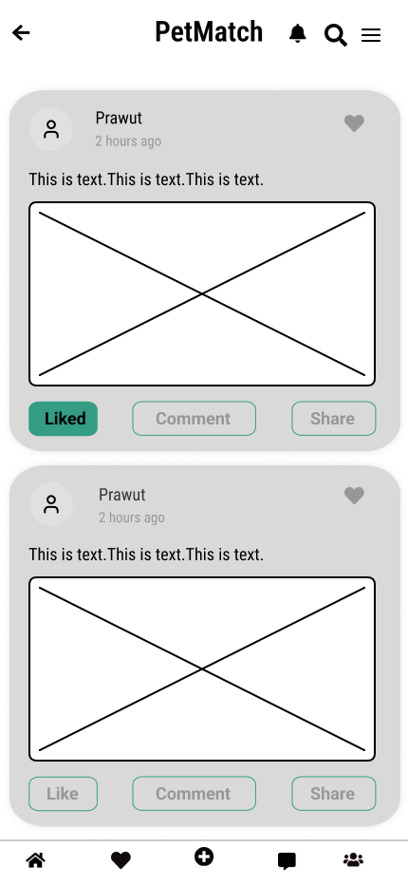
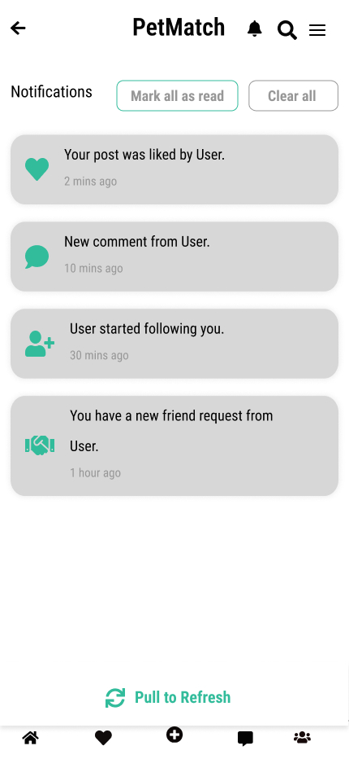
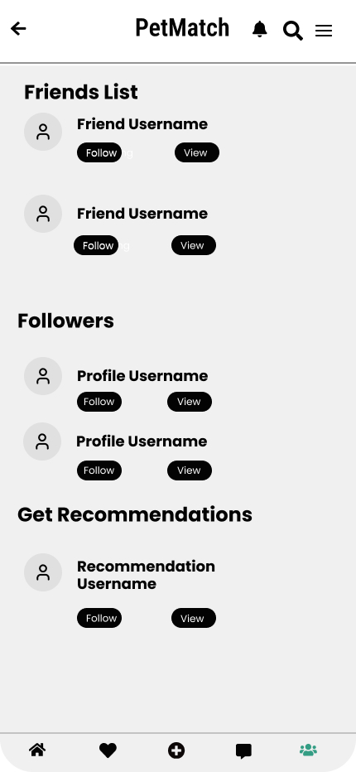
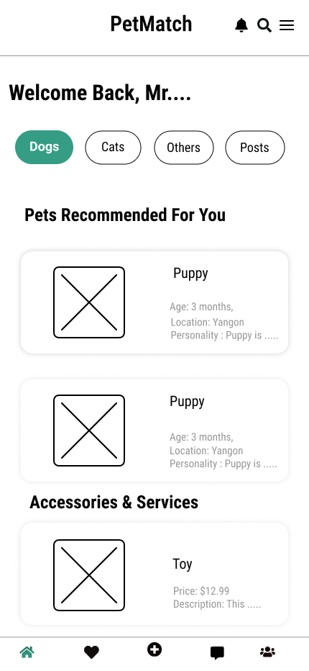
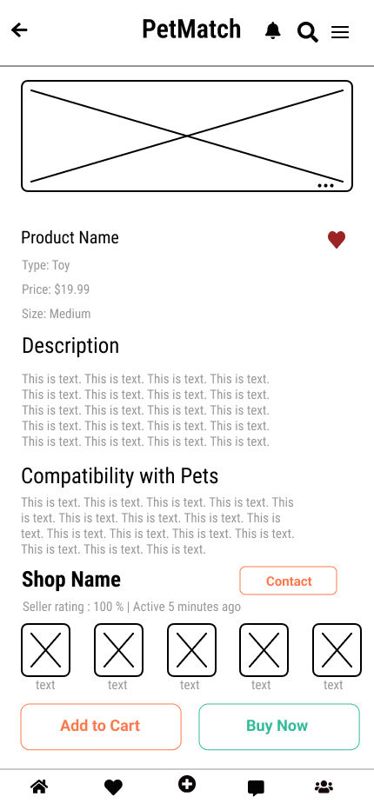
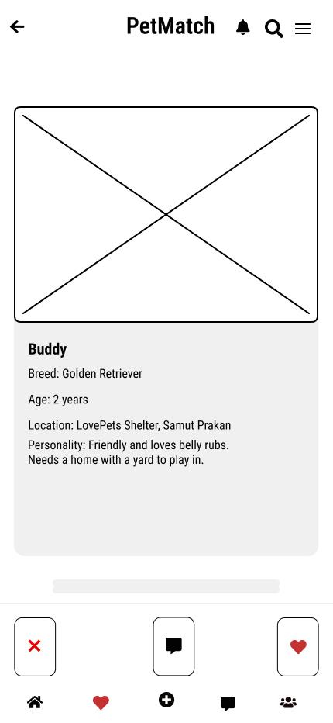
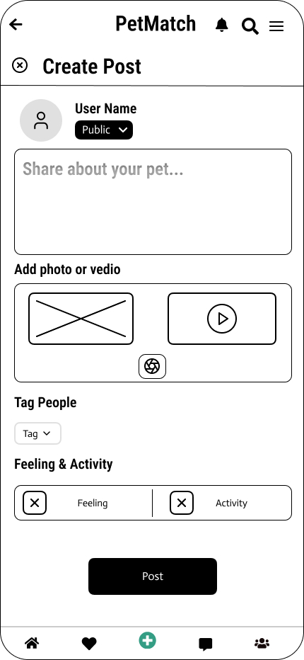
Wireflow
Newsfeed page
Notifications page
Friends and follower page
Loads
friends & followers page
Loads notifications page
Loads newsfeed page
Loads
matched pet page
Loads
create post page
Loads product page
Home page
Product detail page
Matched Pet Page
create post page

Slide 7
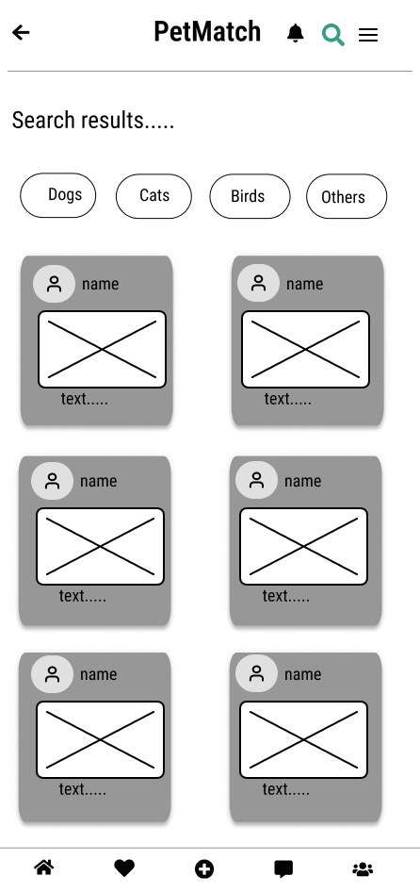
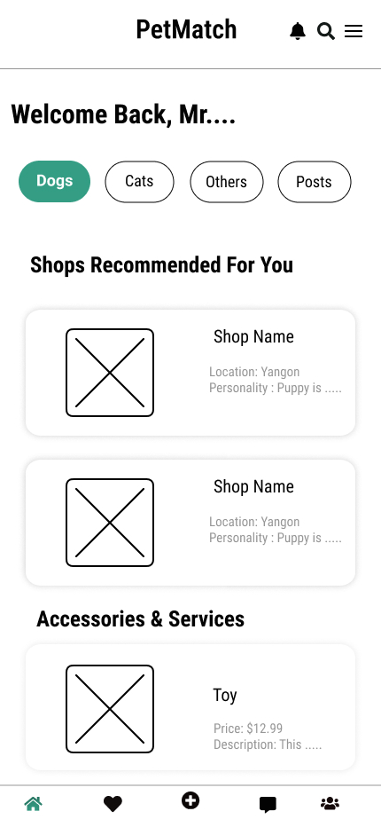
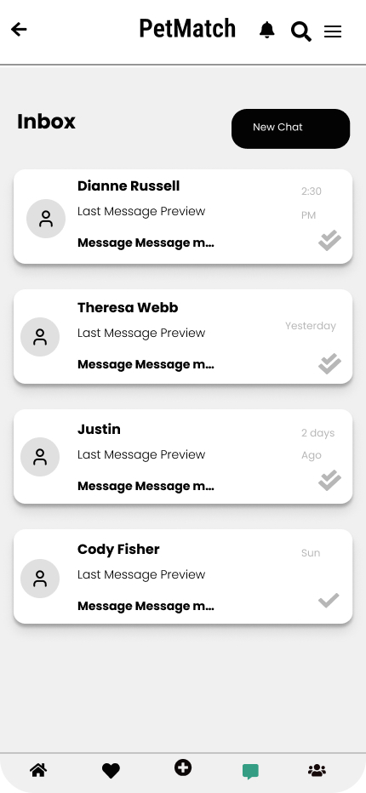
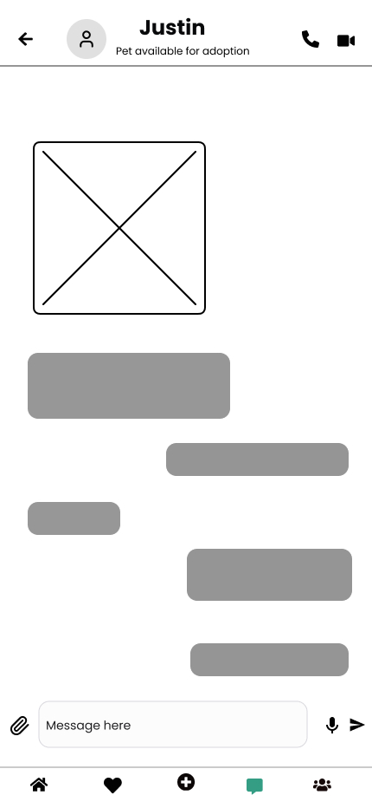
Wireflow
Searched results page
Click to Search
Loads chat interface page
Loads chat inbox page
Home page
Chat inbox page
Chat interface

Slide 8
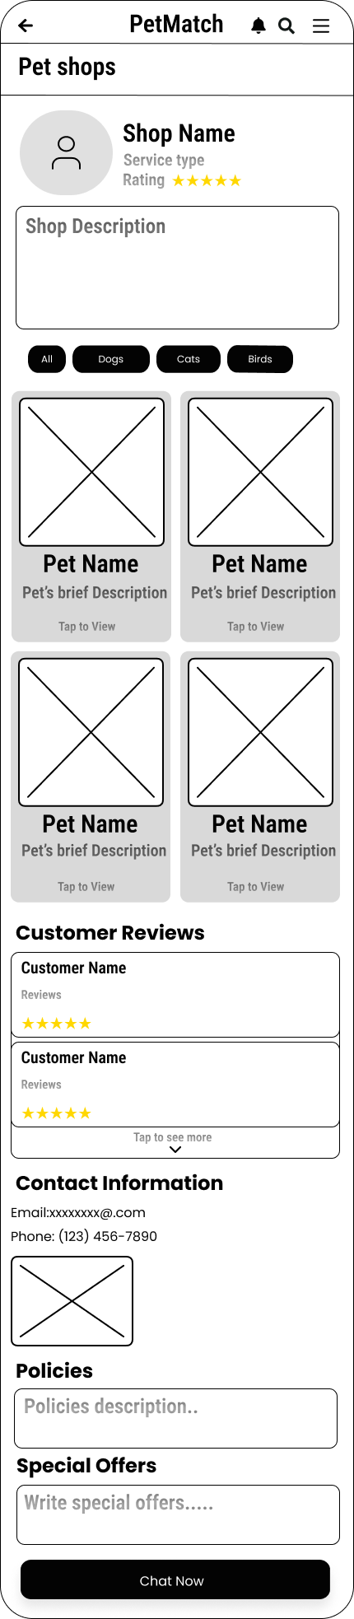
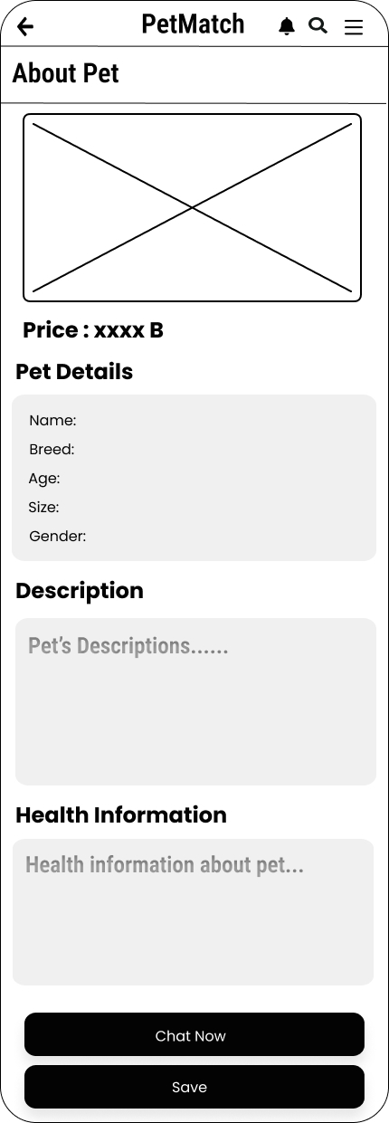

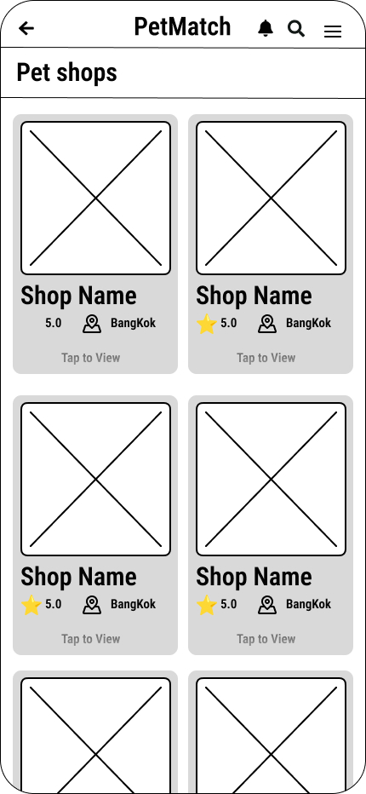
Wireflow
Click to go
pet shops
Click to
see shop
details
Click to ​
see pet's details
Chat with
the shop
Pet Detail
Chat Page
Home Page
Pet shops Page
Shop Detail
Notes:
(3) If you click on a specific shop, you should show that specific shop instead of Pet shops Page.

Slide 9
Assignment: Create the sitemap of you project
45 mins
Objective
To understand and be able to create the sitemap of your project.
Instructions
Refer to your project, list the information that you will provide to users.
Then, group related information together.
Next, arrange the groups of information into a hierarchy.
Finally, create the sitemap in your worksheet.

Slide 10
Sitemap (example)
Main
Search
Settings
Profile
Information
Search by camera
Oder of results
Email
Latest news
Search by image
Phone
Similar images
Search results
Language
Related videos
Currency
Shopping

Slide 11
Assignment: Create the sitemap of you project
Grading Criteria
0 = Blank
1 = Incomplete or information is not in the right group.
2 = Information is in the right group although the hierarchy is not well organized.
3 = Information is in the right group and the hierarchy is well organized.

Slide 12
Sitemap
Main
Pet Adoption
Communication
Marketplace
Feed
Match
suitable pets
Messages
Pet Accessories
Create Post
Search Pets
Chat with Shops/Sellers
View Posts
Buy
Search by filters
Sell
Like/Comment/Share
Search by Keyword
Pet Services
Groups/ Communities
Pet Profiles
Find Services
Post-Adoption Support
Book Services
Notes:
(3) OK

